Slide 1
HOW TO USE A FIRE EXTINGUISHER
Presented by the Seattle Office of Emergency Management

Slide 2
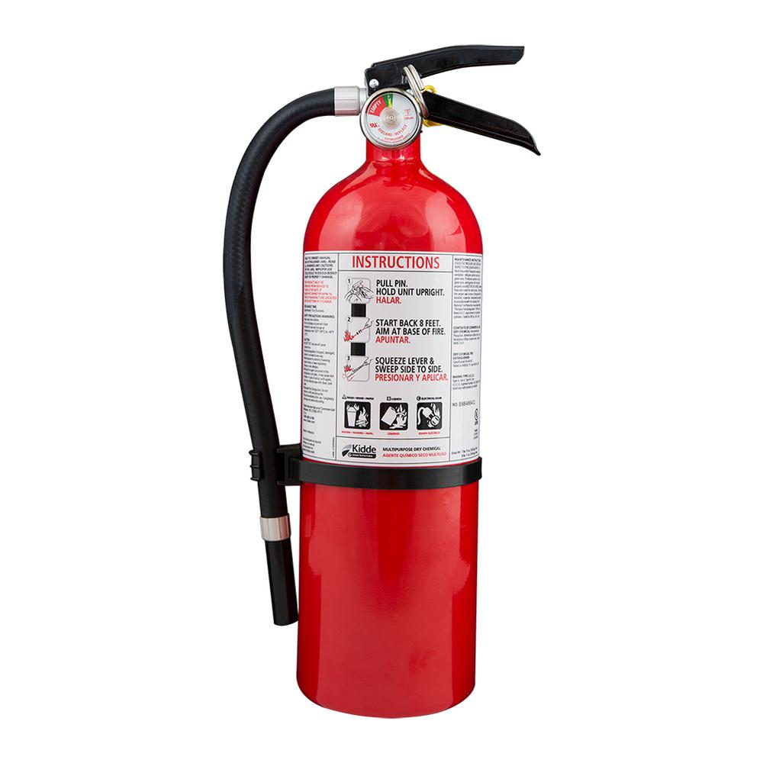
The objective of this training is to become familiar with a fire extinguisher and how and when to use it.

Slide 3
SAFETY RULES FIRST
Use fire extinguisher ONLY if you have been trained to use it.
Fire Extinguishers are for small fires in the early stages, or as big as a trash can.
Always have an exit plan when putting out a fire. Make sure that your back is facing an exit.
All fire extinguishers should have an inspection tag and trigger seal and a pin.
Use ALL contents in the Fire Extinguisher and do not try to use again until refilled.

Slide 4
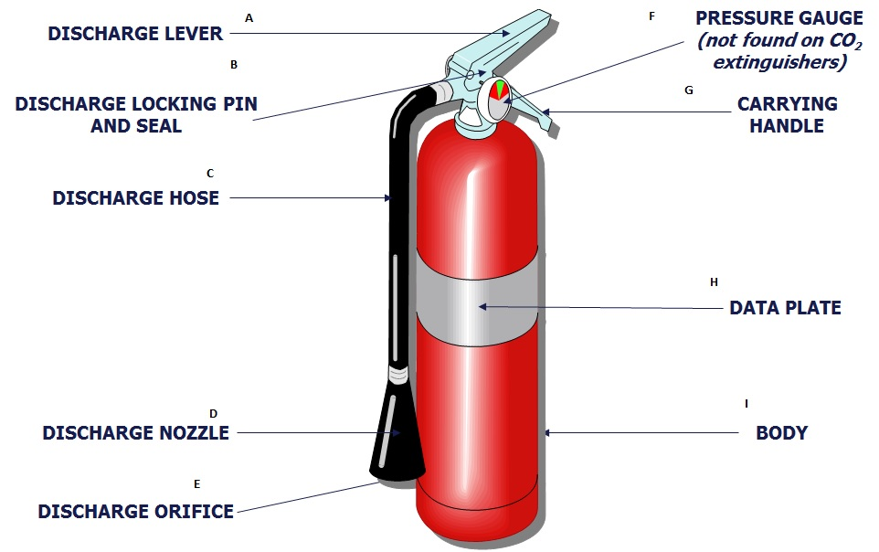
Anatomy of a Fire Extinguisher

Slide 5
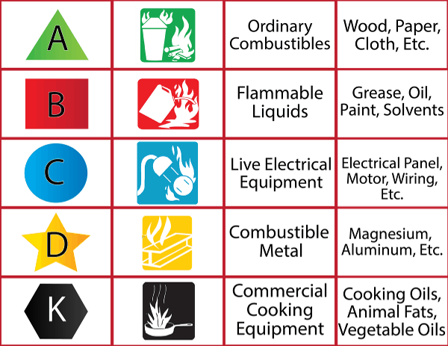
Different Types of Fires
ABC Fire Extinguishers will put out all types of fires, and most fire extinguishers are ABC.

Slide 6
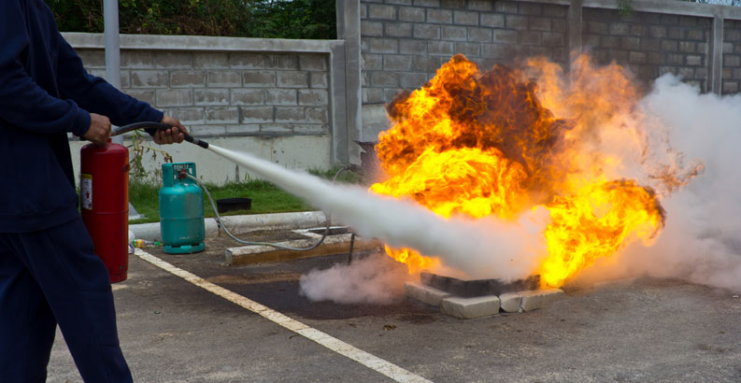
How to use a Fire Extinguisher
When using a Fire Extinguisher position yourself 6-8 feet away from the fire, and stand in an upright position holding the extinguisher firmly with both hands.

Slide 7
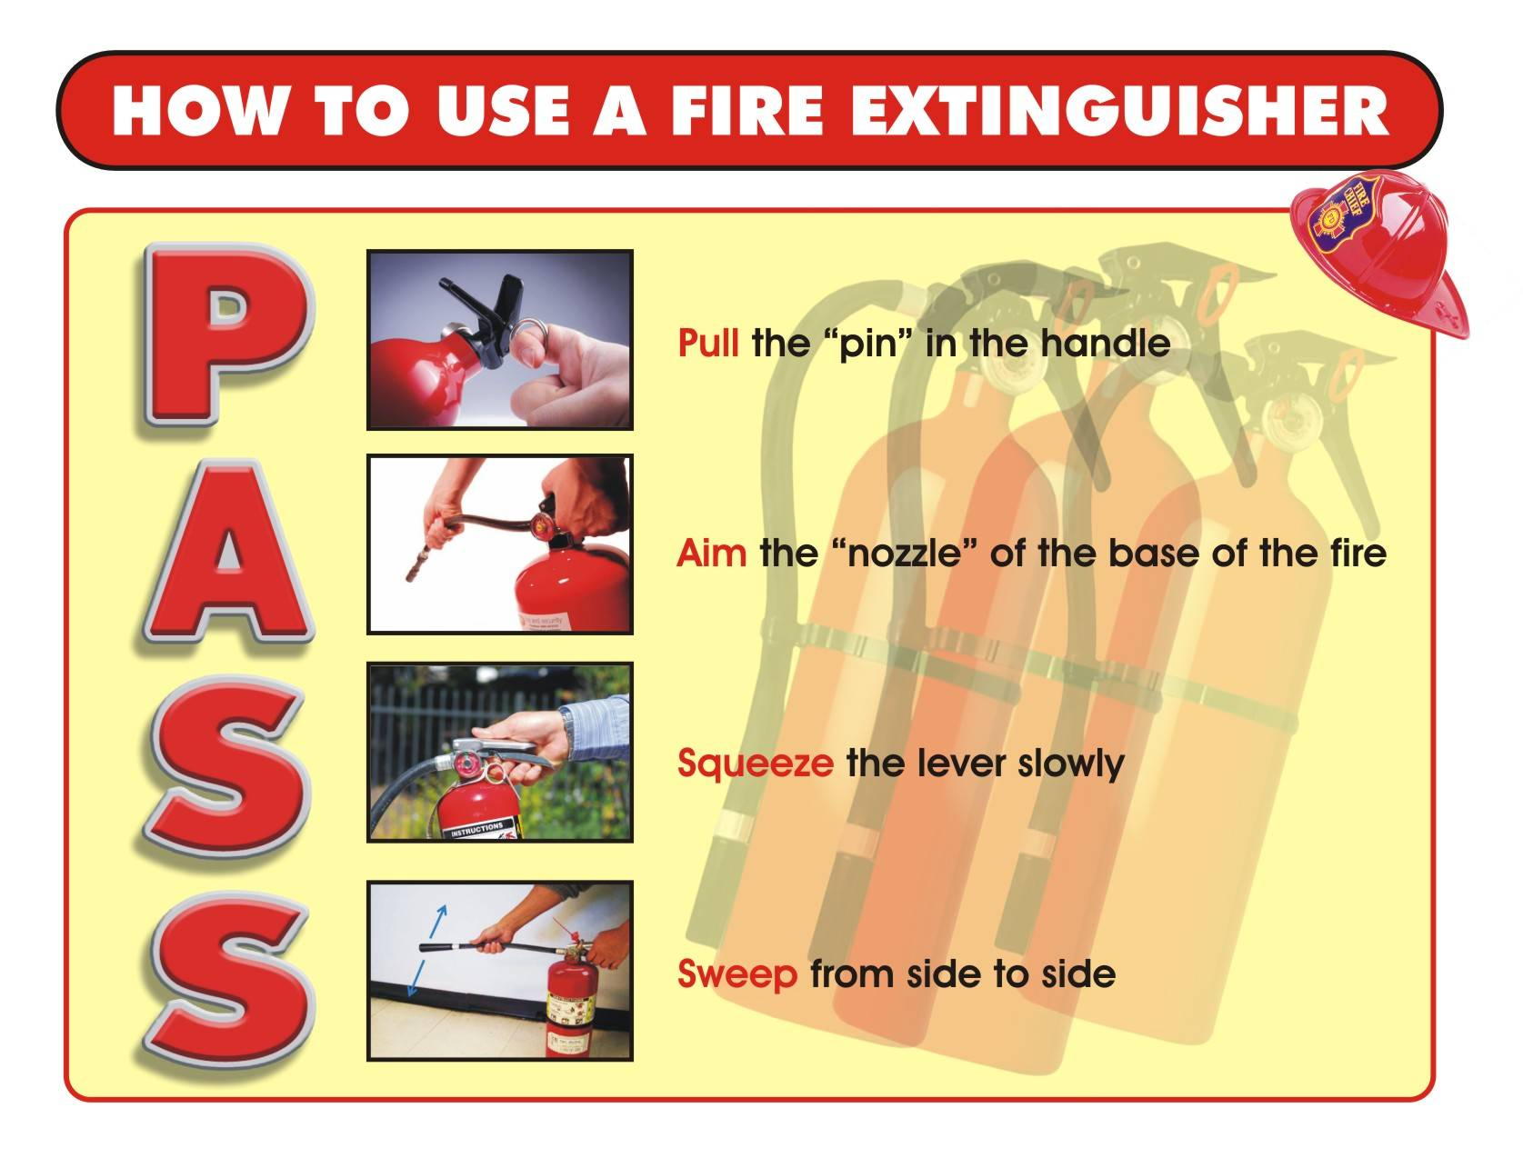
How to use a Fire Extinguisher
Once you have positioned yourself appropriately then utilize the PASS method.
P-pull the pin breaking the wire or plastic
A- aim the nozzle at the base of the fire
S- Squeeze the handle to release the agent
S- Sweep the nozzle back and forth to cover the burning material

Slide 8

Questions?
Thank you for attending- you’ll be happy you prepared ahead of time when the next disaster strikes!

